Slide 1
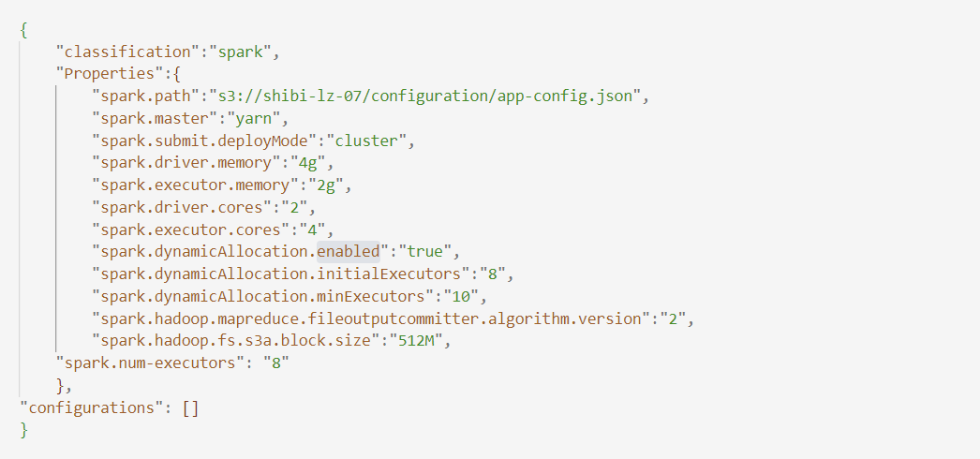
Milestone 3 - Spark Config

Slide 2
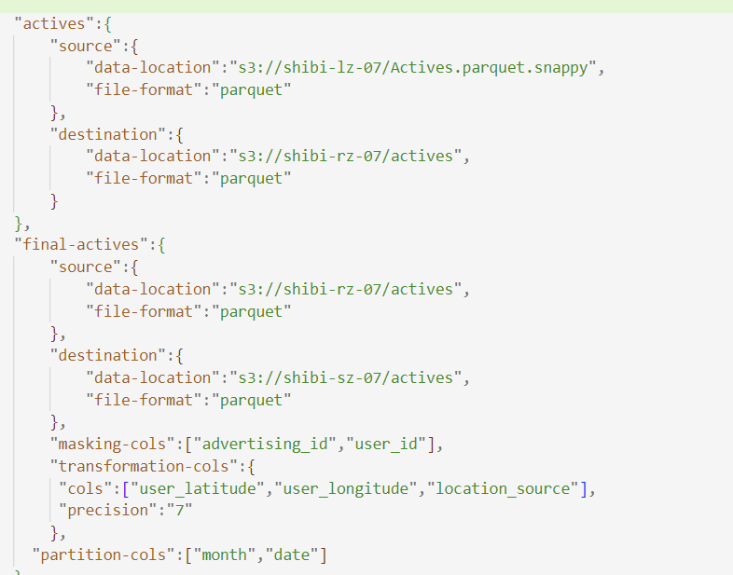
Milestone 3 – App Config

Slide 3
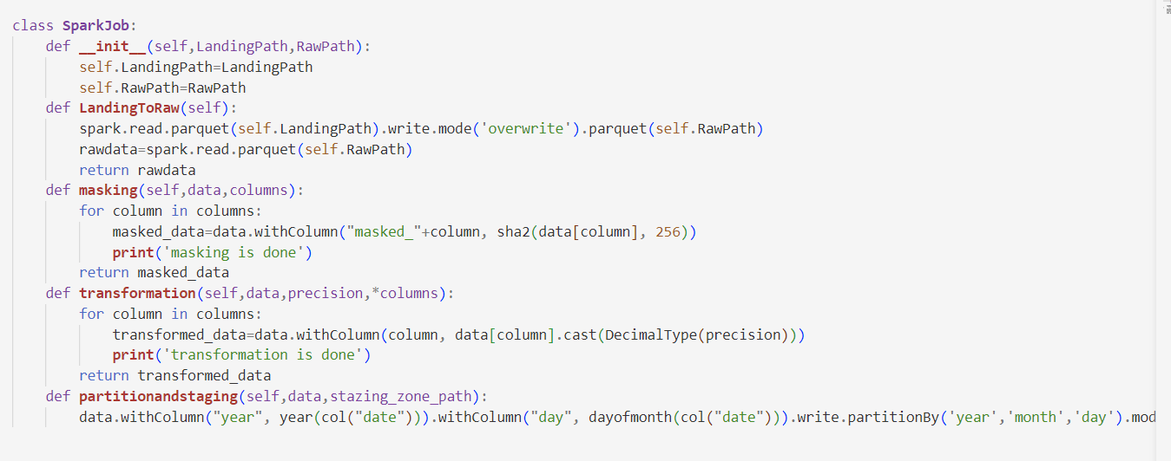
Milestone 3 – Spark Job

Slide 4
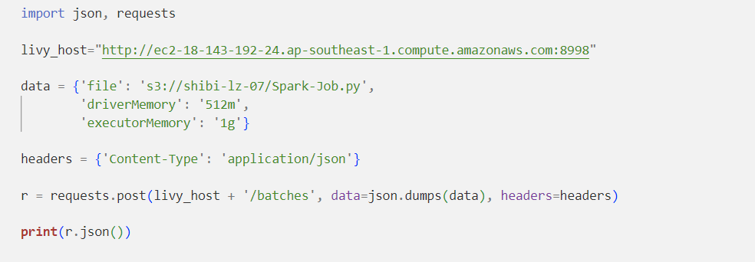
Milestone 4 –Livy Job

Slide 5
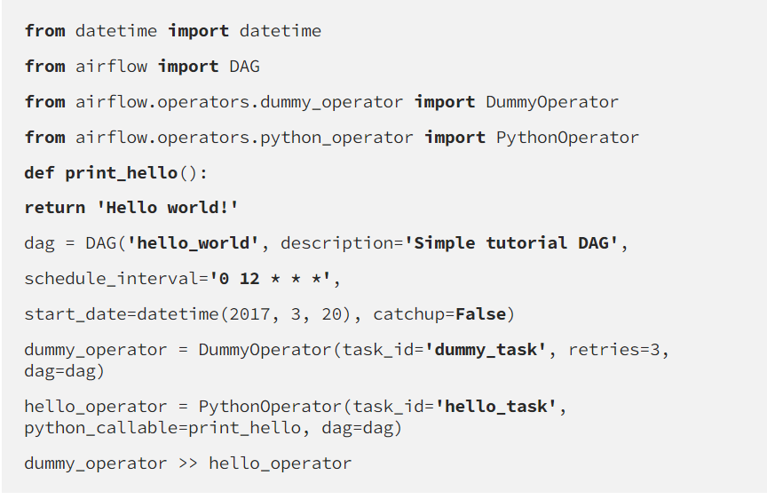
Milestone 5 –DAG

